Slide 1
Why Mandarin?

Slide 2
Improving Scottish Education, HMIE, 2006
“The development of pupils’ understanding… depends greatly on the acquisition of knowledge and critical thinking skills”
Notes:
Antonella Sorace, Professor of Developmental Linguistics at Edinburgh University ,Professor Sorace is especially interested in the benefits of early language learning. As she points out, it is a lot more than just “learning two languages.” Learning another language brings other benefits including:
Social and cultural advantages
Job opportunities and scope for travel
Most importantly, it brings vastly improved cognitive skills

Slide 3
“Provide an external stimulus to challenge assumptions , stimulate ideas and illustrate teaching approaches.”
‘Teaching Scotland’s Future’, Donaldson, 2011
Notes:
Relevant, enjoyable and challenging learning reinforced. Building on good practice
Contribution of MLs to areas of responsibility for all, particularly literacy and global citizenship
MLs part of the BGE. No specified number of hours. MLPS still P6/7
Growth of interest in Chinese
Revised SQA examinations with more options
Political will to do more in Scotland

Slide 4
一
二
三

Slide 5
1 2 3

Slide 6
十

Slide 7
10

Slide 8
十一

Slide 9
11

Slide 10
十二

Slide 11
12

Slide 12
十三

Slide 13
13

Slide 14



月
yuè

Slide 15
Month

Slide 16
月

Slide 17
一月

Slide 18
January

Slide 19
二月

Slide 20
三月

Slide 21




rì

Slide 22
Day or Sun

Slide 23
月

Slide 24
Month

Slide 25
míng
明

Slide 26
Month and sun = “ming”
Bright – as in the weather
Intelligent
Enlightened, wise

Slide 27
rén
人

Slide 28
person

Slide 29
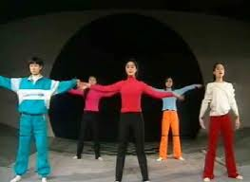
dà
大

Slide 30
big

Slide 31
xiǎo
小

Slide 32
small

Slide 33
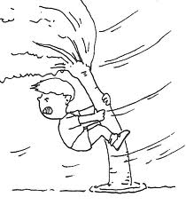
fēng
风

Slide 34

yǔ
雨

Slide 35


yǔ sǎn
雨伞

Slide 36

xuě
雪

Slide 37

xuě rén
雪人

Slide 38

shàng
上

Slide 39

xià
下

Slide 40

xià xuě
下雪

Slide 41

xià yǔ
下雨

Slide 42

xià dà yǔ
下大雨

Slide 43

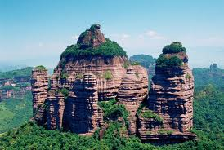
shān

Slide 44

huǒ shān
火山

Slide 45

bīng
冰

Slide 46

bīng shān
冰山

Slide 47
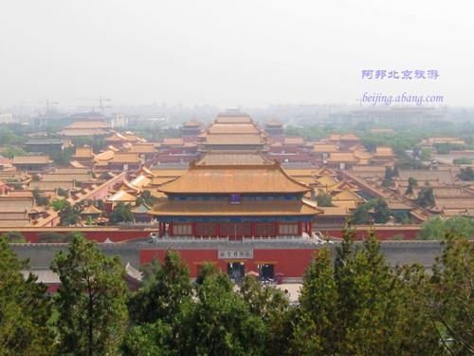


gōng
宫

Slide 48

bái gōng
白宫

Slide 49
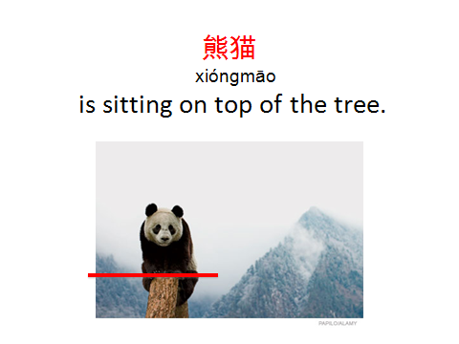

Slide 50
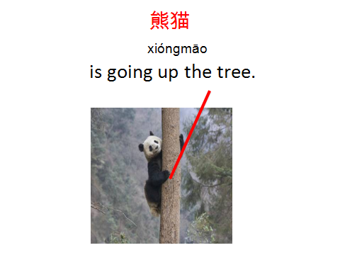

Slide 51
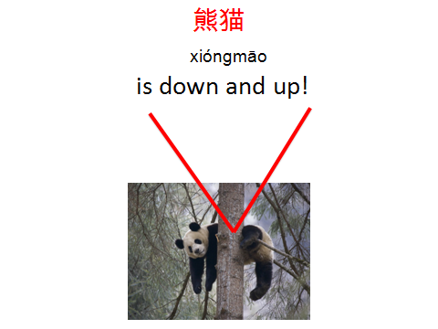

Slide 52
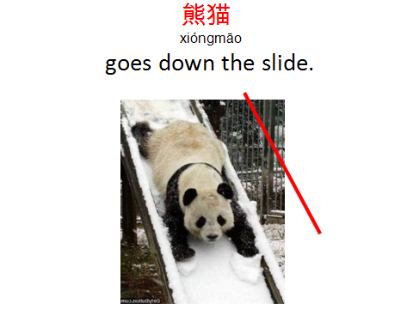

Slide 53
Primary vocab, radicals, sentence structure and story themes
P4 | P5 | P6 | P7
人 person/people | 人person/people | 日sun | 水mountain
大 big | 从 follow | 月moon | 水力 waterpower
大人 adults | 众 crowd | 明 bright | 山 mountain
天 sky/heaven/god | 火 fire | 明天 tomorrow | 山水 landscape
夫 distinguished husband | 炎 scorching | 女 female | 火山 volcano
田 rice field | 焱 flame | 子 son | 雪山mountain with snow
力 power | 土 soil/ground | 好good | 冰山 mountain with ice
口 mouth/enclosure | 坐 sit | 安 secure | 天下 the world
囚 prisoner | 竹 bamboo | 王 king | 衣 cloth
旦 dawn | 毛 hair | 玉 jade | 大衣 big coat
但 but | 笔 pen | 国 kingdom | 雨衣 raincoat
早 morning | 毛笔 pen brush | 王子 prince | 风衣 wind proof jacket
上 up | 家 house | 天子 emperor ( explain the power of the emperor) | 毛衣 woolly jumper
下 down | 家人 family | 中国 China | 长裤 trousers
山 mountain | 雨 rain | 美国 America (big goat beautiful country) | 连衣裙 dress
上山go up to the mountain | 雪 snow | 法国 France ( country with the order of the law) | 裙子skirt
下山come down the mountain | 下雨raining | 英国 Britain (the British empire – hero kingdom) | 苏格兰裙子Kilt (Scottish skirts)

Slide 54
下山come down the mountain | 下雨raining | 英国 Britain (the British empire – hero kingdom) | 苏格兰裙子Kilt (Scottish skirts)
出口Exit | 下雪snowing | 德国 Germany (why is De?) | 衬衫 Shirt
唱 Sing | 雪人snowman | 日本 Japan (the foundation of the sun) | T恤衫 T shirt
木 Tree | 水 water | 苏格兰 Scotland (come back to life, tartan, peaceful, orchid) | Read the story and fill in the gaps using Chinese characters from a bank of words.
林 Wood | 冰 ice | 房子 house (how a house is built – bricks)
森 Forest | 冷cold | 我住在小的房子 I live in a small house
人 person/people | 热hot | 我住在大的房子 I live in a big house
休 rest (the concept of a rest under a tree) | 茶 tea (the story of tea) | 我家在苏格兰 My family is in Scotland
小 small | 可乐 cola | 我爱我的家．I love my family
小人mean people (not a gentle kind person) | 我叫 I’m called | 我喜欢茶 I like tea
心 heart | 我九岁 I’m nine. | 我喜欢可乐 I like cola
小心 careful | 我爱可乐 I love cola | 我在喝茶 I am drinking tea
小孩 child/children | 我不爱可乐 I don’t love cola | 我喜欢喝中国茶也喜欢喝英国茶 I like drinking Chinese tea as well as British tea.
尖 sharp/pointed | 我爱冰可乐，冰可乐很冷 I love iced cola, iced cola is very cold | 下雪时我喝中国茶 When it’s snowing, I drink Chinese tea.
 | 我也爱茶， 茶很热. I also love tea, tea is very hot. | 下雨时我喝英国茶 When it’s raining, I drink British tea
 | 我的笔尖 My pen is sharp. | 下雪很冷但有时不冷 Snow is very cold, but sometimes snow is not very cold.
P4 - theme | P5 - theme | P6 - theme | P7 - theme
Meeting a panda in Edinburgh Zoo | Celebrating in China e.g. birthdays, festivals, etc. | Silk Road which is continued to P7 (link to Europe) | Silk Road linked to art, landscape (mountains, water, rivers ) and belief systems in China

Slide 55

How will we do this?
Notes:
1) Steady input from P1 – integral part of the curriculum – reinforced every day across all curriculum areas – STILL AIMING FOR “SECURE” IN 2ND LEVEL. Richard’s model in Borders – whole school involvement, both pupils and teachers.
BENEFITS of QUALITY ELL -
Better pronunciation/Less self-conscious/Willingness to take risks
increased motivation, enthusiasm and developing confidence
2) BUT L3 not to the same depth. Criticism of carrousel approach. Maybe a carefully planned interdisciplinary approach, or through an elective or enrichment activity which runs for all or part of the session. Need to see genuine progression in L3 ,

Slide 56
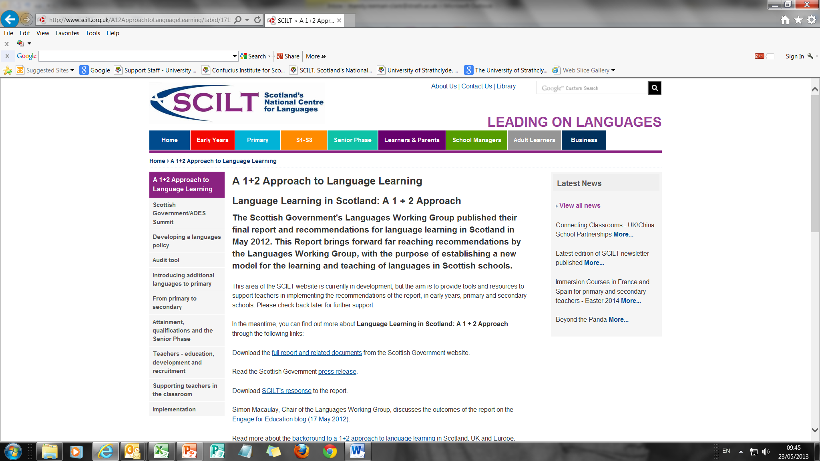
Notes:
1+2: making a difference Focus on skills – literacy and transferrable
Others offer new, exciting possibilities – radical but necessary to turn the ship around, e.g.
Transition which ensures progression and continuity from primary to secondary for L1
P1 start for +1
Provision of a second modern language (L2)
Benefits of early start; languages as integral to primary curriculum; all Ts involved; preserving diversification and supporting personalisation/choice
once in primary

Slide 57
What do we mean by 1+2?
More depth, challenge, variety of contexts; ensure progression in all 4 skills; develop learner confidence in self/peer evaluation, error correction and independent learning
No expectation that all primary teachers will have to be MLPS trained in traditional sense. Key element is basic language+ showing them how good primary pedagogy is perfect when applied to ML.
Notes:
avoid kind of duplication which de-motivates.
Be able to evaluate their own and their classmates’ work
Spot and correct errors
Look for information independently and be confident using a bilingual dictionary

Slide 58
Clarifying L3
L3 does not have to take the form of an IDL project. It can be introduced through a variety of approaches such as inserts, IDL, SQA Languages for Life and Work Award as long as…there are clear opportunities for language learning and for progression.
The choice of language for L3 is for schools to decide, based on the needs of the learning community and skills of staff.
The expectation for 2020, is NOT that all P1-7 will get L2 AND that all P5- S3 will get L3, but rather that that schools/LAs are working towards this – have strategic and operational plans. Minimum expectation would be that all P1s in 2020 are getting L2. Guidance will come from SIG, but for schools, clusters and LAs to decide time scales and set targets.
Notes:
Following slides examples of how to approach introducing Mandarin – it engages parents very much; gives ample scope for working in partnership with others; engaging with the community local or global

